Slide 1


Slide 2



Windows 11

Slide 3

WINDOWS 11
Select Your Preferred Language:
English (US)
▶

Slide 4
WINDOWS 11
Please Enter The Product Key:
B1PU
L7AM
SA8R
WI7N
✅

Slide 5
WINDOWS 11
Select Your Windows Version 🔽
1. Windows 11 Home
2. Windows 11 Professional
3. Windows 11 Community
NEXT

Slide 6

MICROSOFT SOFTWARE LICENSE TERMS
WINDOWS OPERATING SYSTEM
IF YOU LIVE IN (OR IF YOUR PRINCIPAL PLACE OF BUSINESS IS IN) THE UNITED STATES, PLEASE READ THE BINDING ARBITRATION CLAUSE AND CLASS ACTION WAIVER IN SECTION 11. IT AFFECTS HOW DISPUTES ARE RESOLVED.
Thank you for choosing Microsoft!
Depending on how you obtained the Windows software, this is a license agreement between
you and the device manufacturer or software installer that distributes the software with your device; or
you and Microsoft Corporation (or, based on where you live or, if a business, where your principal place of business is located, one of its affiliates) if you acquired the software from a retailer.
✅
I accept The License Of Microsoft Windows

Slide 7
Choose The Option
UPGRADE
Upgrade Old Windows To New
CUSTOM
Select The Custom Partition
NEXT

Slide 8

Select The Partition:
C: Partition(Recommended)
Space Available : 256GB (SSD)
D: Partition
Speed : 550 mb/s
Status : Active
E: Partition
NEXT

Slide 9

Copying Files
100%
Expanding Files
100%
NEXT

Slide 12
Windows 11

Slide 13
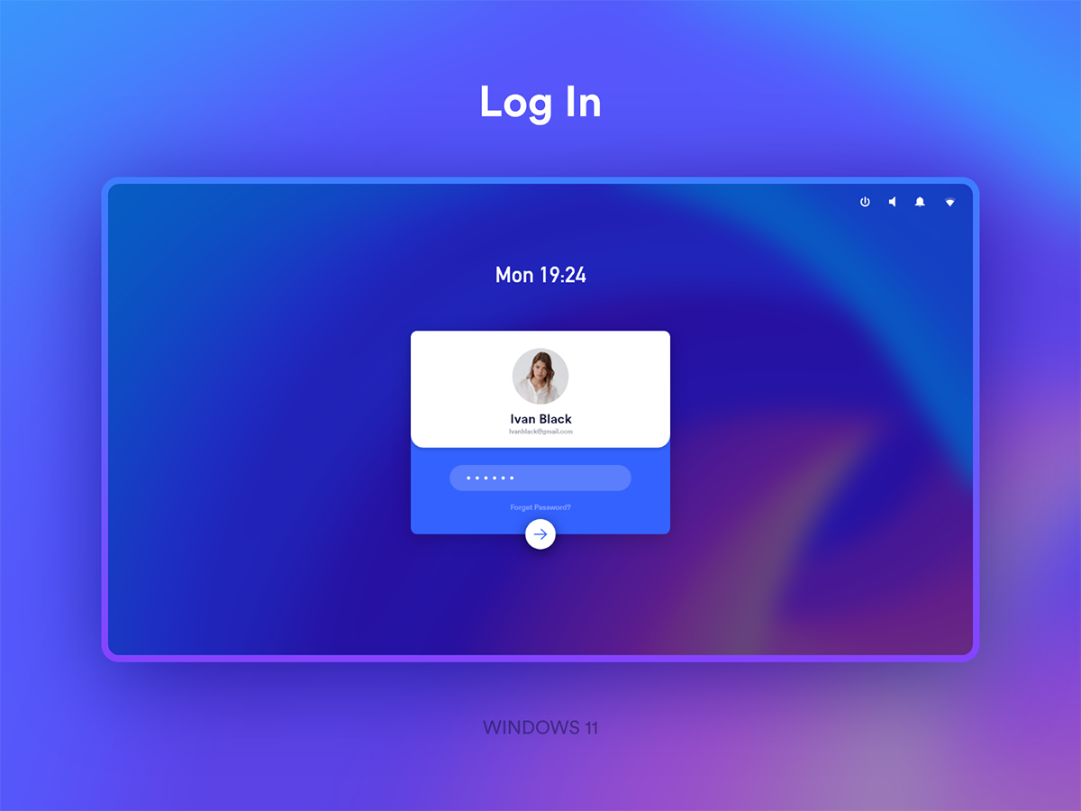









7/6/2020
5:45 pm
Select The Lock
Face ID
Pin
Sensor

Slide 14


7/6/2020
5:45 pm
SET YOUR LOCK
Username
Passcode

Slide 15

Just a moment

Slide 16











7/6/2020
6:00 pm

Slide 17







7/6/2020
6:00 pm
Pinned Apps
Word Powerpoint Explore Mail
Team Weather Calendar To do
Recently Opened
Youtube.com 10min ago
Backup Files 2hrs ago
⚙ 🔌

Slide 18






7/6/2020
6:00 pm
⬛
X
File Explorer
Path
Search
Quick access
Desktop
Downloads
📁 Recent Files
📥 Downloads
🎵 Songs
Music
Documents
🎥 Movies
📷 Pictures
D; 820 Gb Free
C; 230 Gb Free

Slide 19






7/6/2020
6:01 pm
⬛
X
File Explorer
Files > Pictures
Search
Quick access
Desktop
Downloads
📁 Recent Files
📥 Downloads
🎵 Songs
Music
Documents
🎥 Movies
📷 Pictures
D; 820 Gb Free
C; 230 Gb Free

Slide 20
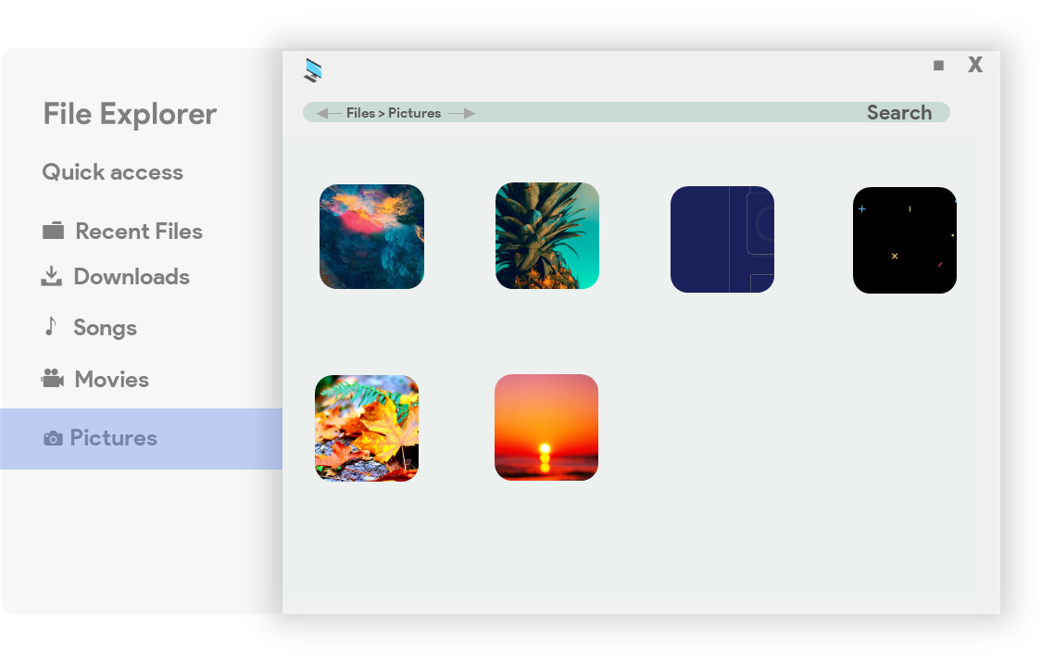
7/6/2020
6:01 pm

Slide 21
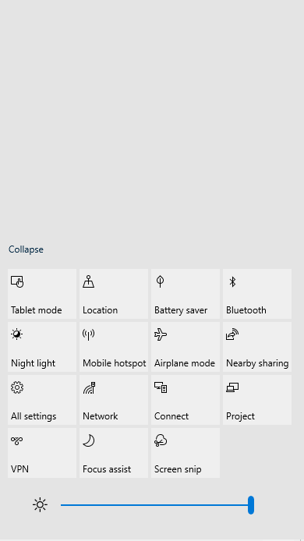
7/6/2020
6:01 pm
Notifications
Subscribe to PPoint
Welcome to Windows 11 beta

Slide 22
7/6/2020
6:02 pm
Notifications
Subscribe to PPoint
Welcome to Windows 11 beta

Slide 23
7/6/2020
6:02 pm
⬛
X
Settings
Settings
Search
Quick access
💻
🔋
👀
💻 System
🔋 Battery
System
Battery
Appearance
👀 Appearance
🌐 Time/Language
🌐
📷
+
📷 Devices
Time/language
Devices
Load More

Slide 24
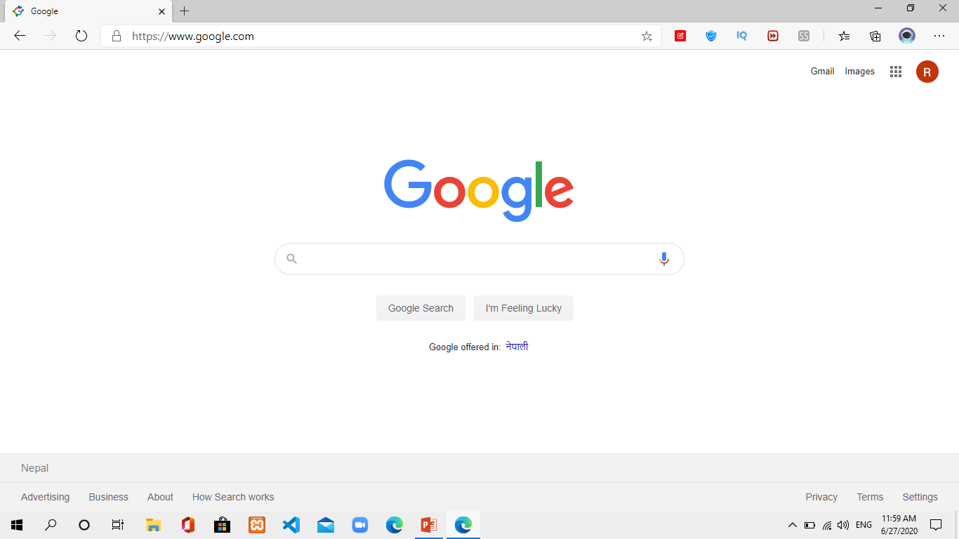
4/6/2020
5:45 pm

Slide 25
7/6/2020
6:02 pm

Slide 26
7/6/2020
6:02 pm
Pinned Apps
Word Powerpoint Explore Mail
Team Weather Calendar To do
Recently Opened
Youtube.com 10min ago
Backup Files 2hrs ago
⚙ 🔌📱

Slide 27
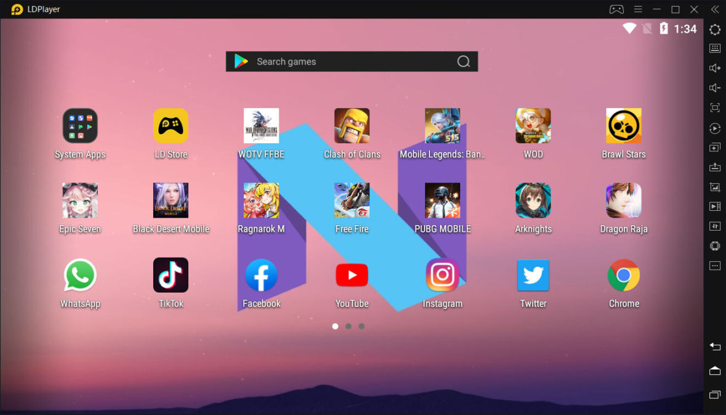
7/6/2020
6:03 pm

Slide 28
7/6/2020
6:03 pm
Pinned Apps
Word Powerpoint Explore Mail
Team Weather Calendar To do
Recently Opened
Youtube.com 10min ago
Backup Files 2hrs ago
⚙ 🔌📱

Slide 29
Shutting Down

